Slide 1
Sentiment Analysis of Flight Reviews
Sentiment Analysis of British Airways reviews from Skytrax website
By Ankit Chowdhury

Slide 2
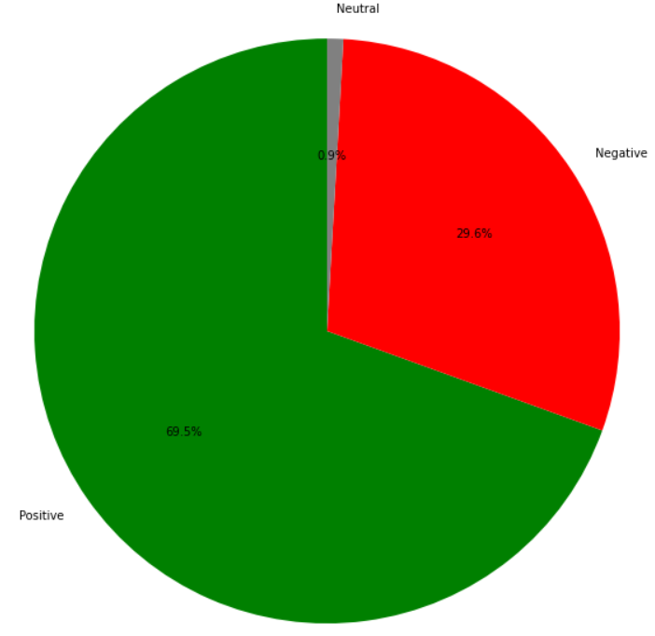
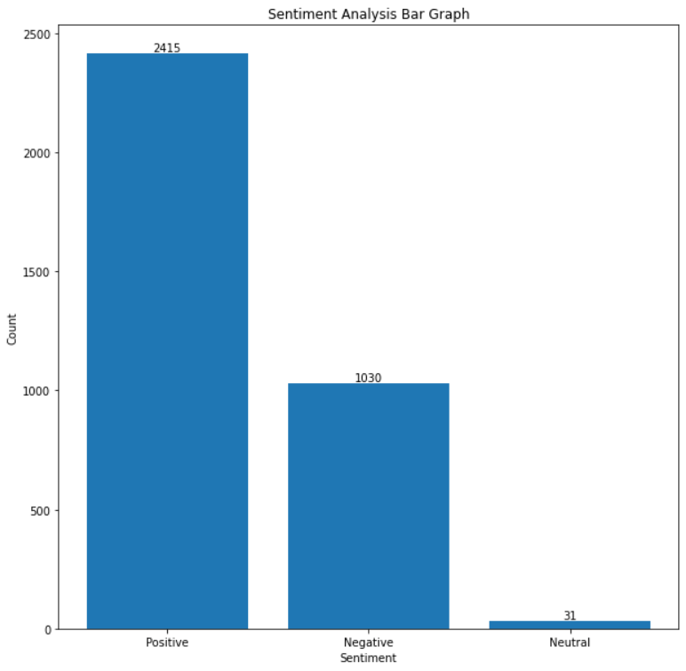
Overall Sentiment of Public

Slide 3
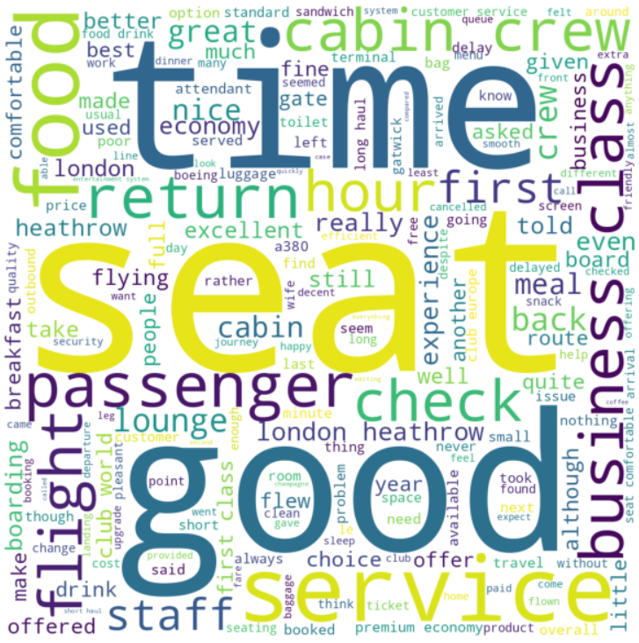
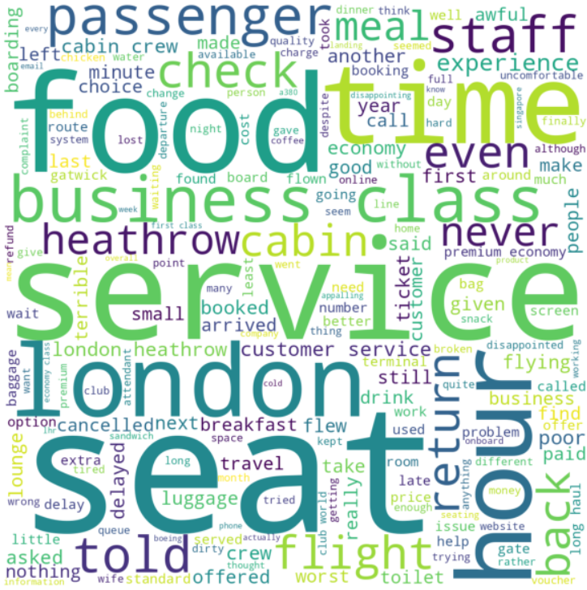
Word Cloud of Positive and Negative Sentiment
Positive Word Cloud
Negative Word Cloud

